Slide 1
Chapter 7
Quantitative Research:
An Introduction to Measurement

Slide 2
Measurement and Scaling Concepts
Understand quantitative research.
Be able to define and explain quantitative research.
Know how and when to use quantitative research.

Slide 3
What Do I Measure?
Measurement
  The process of describing some property of a phenomenon, usually by assigning numbers in a reliable and valid way.
Concept
  A generalized idea about a class of objects that has been given a name, an abstraction of reality that is the basic unit for theory development. Every discipline and theory is made up of concepts, e.g. key ideas, key words, key phrases.

Slide 4
Operational Definitions
Operationalization
  The process of identifying scales that correspond to variance in a concept involved in a research process.
Scales
  A device providing a range of values that correspond to different values in a concept being measured.
Correspondence rules
  Indicate the way that a certain value on a scale corresponds to some true value of a concept.
Constructs
  A term used for concepts that are measured with
  multiple variables.

Slide 5
Levels of Scale Measurement
Nominal
  Assigns a value to an object for identification or classification purposes.
  Most elementary level of measurement.
  Also called as naming scale.
  Data can be qualitative and quantitative
Ordinal
  Ranking scales allowing things to be arranged based on how much of some concept they possess.
  Order matters not the difference between the values
  Can be in tabular or graphical form

Slide 6
Levels of Scale Measurement (cont’d)
Interval
  Interval scales have both nominal and ordinal properties.
  But they also capture information about differences in quantities of a concept.
  No pre-determined starting point or zero value.
Ratio
  Highest form of measurement.
  Have all the properties of interval scales with the additional attribute of representing absolute quantities.
  Absolute zero.

Slide 7
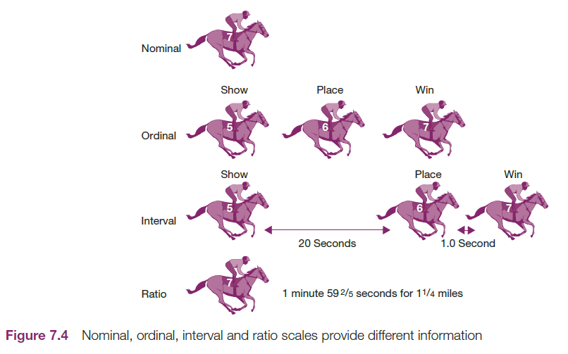
Nominal, Ordinal, Interval, and Ratio Scales provide Different Information

Slide 8
Level | Examples | Numerical Operations | Descriptive Statistics
Nominal | Student ID number Male-Female Buy-Did not buy | Counting | Frequency Mode
Ordinal | Indicate your level of school: High school; College; University. | Counting of ordering | Frequencies, mode, median and range
Interval | GPA Temperature | Common arithmetic operations | Frequencies, mode, median, range, mean, variance and SD. Frequencies, mode, median, range, mean, variance and SD.
Ratio | Annual family income etc.… | All arithmetic operations

Slide 9
Class activity
Q1: IQ of 10 people. Determine the level of measurement that can be used?
a) Nominal b) Ordinal c) Interval d) Ratio
Q2: List of popular video games. Determine the level of measurement that can be used?
a) Nominal b) Ordinal c) Interval d) Ratio
Q3: Age of student. Determine the level of measurement that can be used?
a) Nominal b) Ordinal c) Interval d) Ratio

Slide 10
Mathematical and Statistical Analysis of Scales
Discrete Measures
  Measures that can take on only one of a finite number of values.
  Canno be broken down in smaller parts to make precision.
  Can be counted but cannot measure.
  Consist of distinct or disconnected elements
  Example: number o students in class, number of watches, phones, number of tyres in car etc.
  If plotted on line chart, graph will represent disconnected plot points

Slide 11
Mathematical and Statistical Analysis of Scales
Continuous Measures
  Measures that reflect the intensity of a concept by assigning values that can take on any value along some scale range.
  Data that is non continuous in nature.
  Data can be broken in smaller parts
  Data consists of connected element-continuous in nature
  Data can be in fraction such as weight of students.
  Data changes with time, e.g. weight of the student changes monthly.
  Can be measured not counted

Slide 12
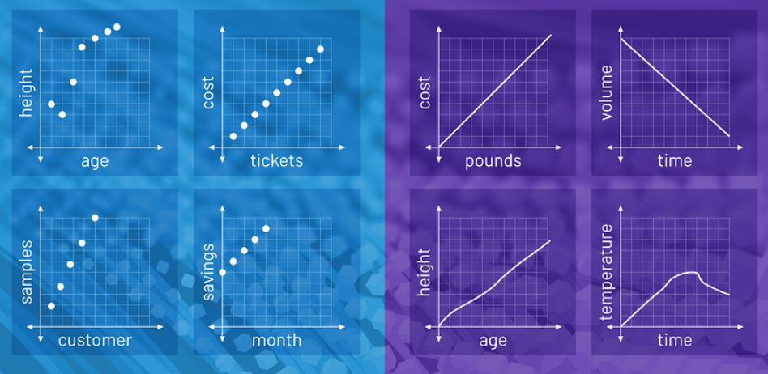

Slide 13
Index Measures
Attributes
  Single characteristics or fundamental features that pertain to an object, person, situation, or issue.
Index Measures
  An index assigns a value based on how much of the concept being measured is associated with an observation.
  Indexes often are formed by putting several variables together.
Composite Measures
  Assign a value to an observation based on a mathematical derivation of multiple variables.

Slide 14
Computing Scale Values
Summated Scale
  A scale created by simply summing (adding together) the response to each item making up the composite measure.
Reverse Coding
  A method of making sure all items forming a composite scale are scored in the same direction. Negative items can be recoded, changing the value of a response to a scale so it is opposite of the original value.
  Done so that negative items in a scale are
  scored in the same direction as positive
  items.

Slide 15
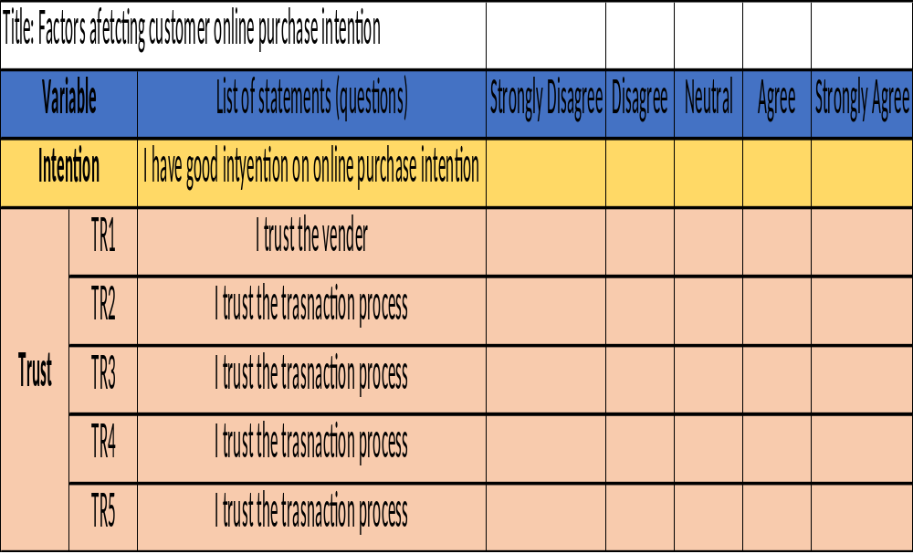

Slide 16
Parametric Test | Non parametric Test
Independent Sample T test | Mann-Whitney Test
Paired Sample T-Test | Wilcoxon Single Rank Test
One Way ANOVA | Kruskal Wallis Test
Pearson’s Regression | Spearman’s Regression
Interval or Ratio | Ordinal or Nominal
Normally Distributed | Not normal data
No outliers | Outliers
Larger sample>30 | Small sample

Slide 17
Example of Non parametric case
Age positively impacts the performance of employee.
Age is ordinal
Performance is measured as Interval (Likert Scale)
Age
Performance

Slide 18
Example of parametric case
Attitude positively impacts the performance of employee
Both Attitude and Performance have been measured using multiple items on Likert Scale range.
Attitude
Performance

Slide 19
Three Criteria for Good Measurement
Reliability
Validity
Good Measurement
Sensitivity

Slide 20
Reliability
Reliability
  The degree to which measures are free from random error and therefore yield consistent results.
Internal Consistency
  Represents a measure’s homogeneity or the extent to which each indicator of a concept converges on some common meaning.

Slide 21
Methods of Reliability
Split-half Method
  A method for assessing internal consistency by checking the results of one-half of a set of scaled items against the results from the other half.
Coefficient alpha (α)
  The most commonly applied estimate of a multiple item scale’s reliability.
  Represents the average of all possible split-half reliabilities for a construct.

Slide 22
Methods of Reliability
Test-retest Method
  Used to estimate reliability.
  Administering the same scale or measure to the same respondents at two separate points in time to test for stability.
  Represents a measure’s repeatability.
Problems:
  The pre-measure, or first measure, may sensitize the respondents and subsequently influence the results of the second measure.
  Time effects that produce changes in
  attitude or other maturation of the subjects.

Slide 23
Validity
Validity
  The accuracy of a measure or the extent to which a score truthfully represents a concept.
    Does a scale measure what was intended to be measured?
Establishing Validity:
  Is there a consensus that the scale measures what it is supposed to measure?
  Does the measure correlate with other measures of the same concept?
  Does the behavior expected from the measure
  predict actual observed behavior?

Slide 24
Validity (cont’d)
Face Validity
  A scale’s content logically appears to reflect what was intended to be measured-expert subjective agreement.
Content Validity
  The degree that a measure covers the domain of interest.
Criterion Validity
  The ability of a measure to correlate with other standard measures of similar constructs or established criteria.
Construct Validity
  Exists when a measure reliably measures and
  truthfully represents a unique concept.

Slide 25
Validity (cont’d)
Convergent Validity
  Concepts that should be related to one another are, in fact, related; highly reliable scales contain convergent validity.
Discriminant Validity
  Represents how unique or distinct is a measure; a scale should not correlate too highly with a measure of a different
  construct.

Slide 26
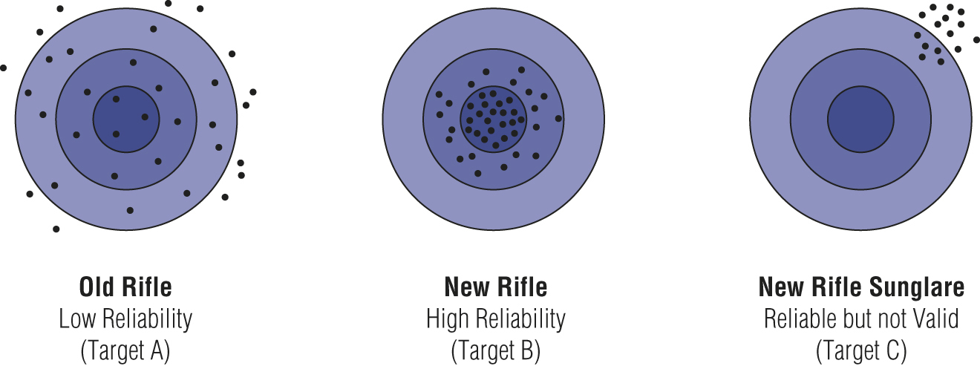
Reliability and Validity on Target

Slide 27
Sensitivity
Sensitivity
  A measurement instrument’s ability to accurately measure variability in stimuli or responses.
  Generally increased by adding more response points or adding scale items.
Notes:
(41) Discrete v/s Continuous Data - What? How? || Discrete Data || Continuous Data – YouTube
(41) Scales of Measurement in Statistics - Nominal, Ordinal, Interval, Ratio | Level of Measurement - YouTube

